Slide 1

Road Test Preparation for the Next Generation
Notes:
After countless hours of engineering, prototyping and innovating, we, The Nebuchadnezzars, are proud that unveil, DMV-R: the biggest the innovation in road test prepration EVER.

Slide 2
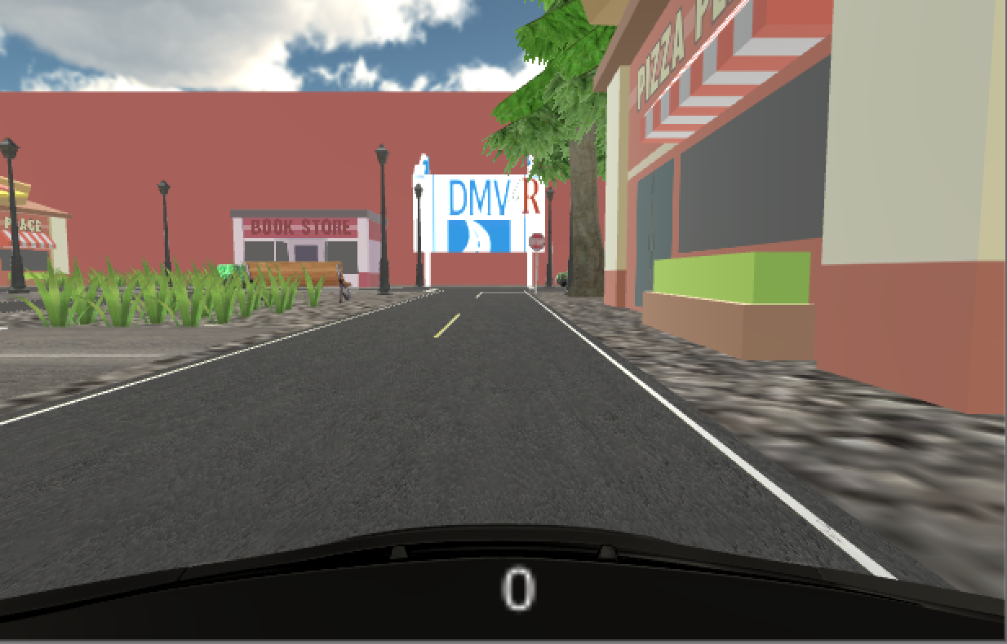
What is DMV-R?
Road Test Simulation Software
Reduce Failure Rate
Reduce Anxiety
Democratize Road Test Preparation

Slide 3

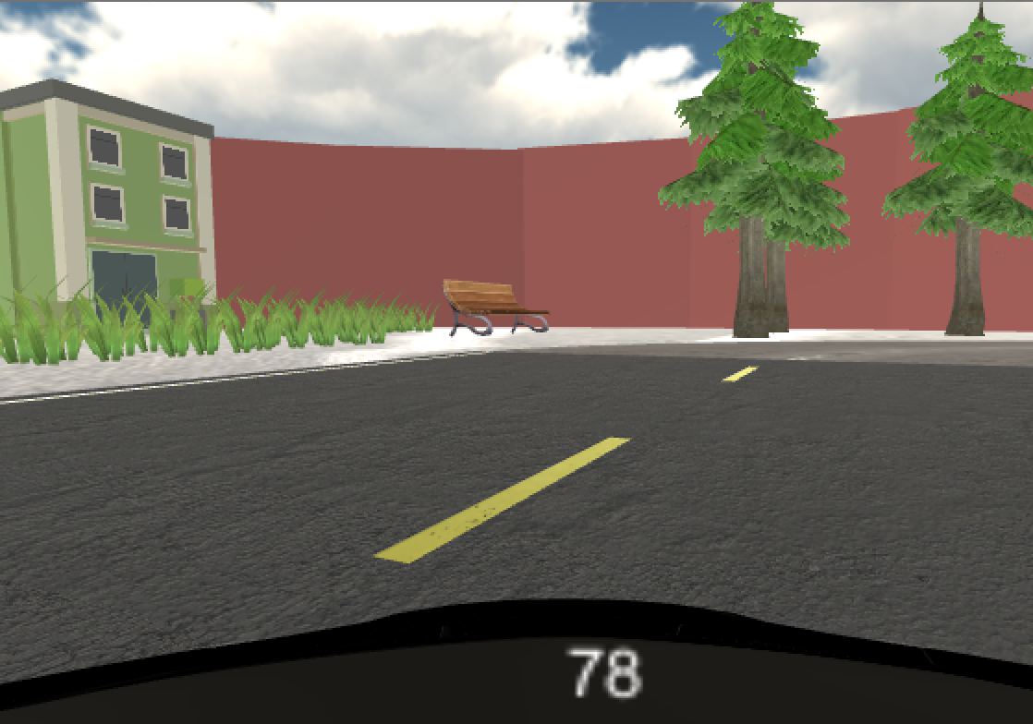


Features
Intelligent AI System
Realistic and Engaging Real World Environment
Audio cues
Simple, Intuitive Point System

Slide 4



How did we do it?
General World
Models / Assets
Networking
Input / Rules

Slide 5



Challenges
My Computer and Android Detection :(
Getting Network Input

Slide 6
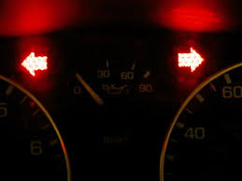


Future Work
Add More Challenges
More Functionality
Turn signals
Backing into a spot
More audio cues

