Slide 1
Out of this World
A VR Experience brought to you by Team WFF:
Emily Reinherz, Nina Lozinski, and Valerie Ding

Slide 2
Goals

Slide 3
Compelling outer space experience – Allow users to feel as though they are truly flying through outer space, with realistic graphics of the solar system
Seamless VR motion control through Kinect – Provide smooth movement in VR through using gestures in Kinect, while aiming to minimize lag and latency.

Slide 4
The Development Process

Slide 5
Milestones
Week 6
Week 8
Week 10
Week 7
Week 9
Started building gesture database using Kinect and Visual Gesture Builder
Built solar system app on Unity, and continued implementing gestures
Tested VR movement through Kinect, added and modified gestures
Built simple Unity app, recorded training videos, and tested gesture detection on Unity
Implemented networking between PC and Android by sending Kinect data through a socket server

Slide 6
Hardware and Software

Slide 7
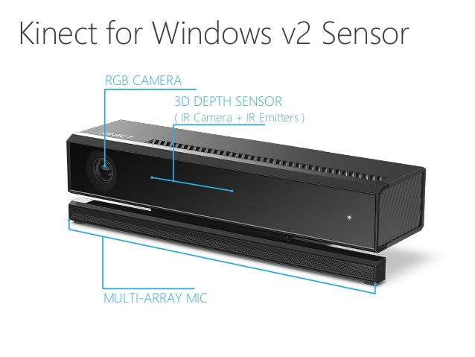

Slide 8
Kinect Studio
Visual Gesture Builder
Record clips of people performing various gestures (leaning forwards and backwards, swaying left and right) in front of the Kinect
“Tag” clips of people moving, identifying which parts of the clips should be recognized as specific gestures
Add training videos to database, and Gesture Builder will “learn” to recognize specific gestures
Build and export gesture database

Slide 9
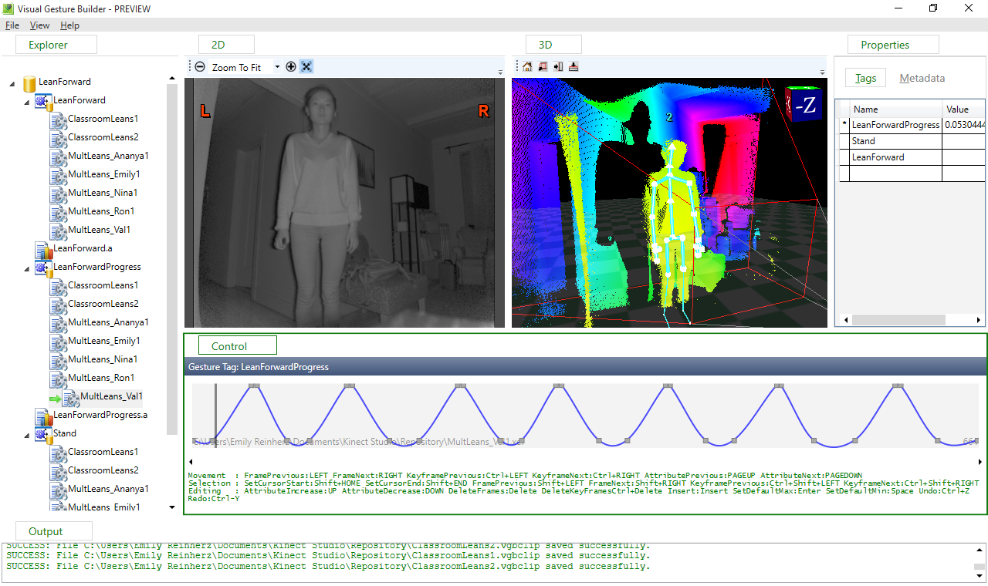

Slide 10
Unity
Gear VR and Android
Build Unity app on Android
Plug into Gear VR headset
Kinect data is sent from Kinect to PC to Android phone
User can move through the solar system in VR using gestures!
Imports our gesture database
Attached scripts grab sensing data from Kinect, compare it to our database and determine if a gesture is being executed
Based on which gesture is detected, player object moves around in the solar system app

Slide 11
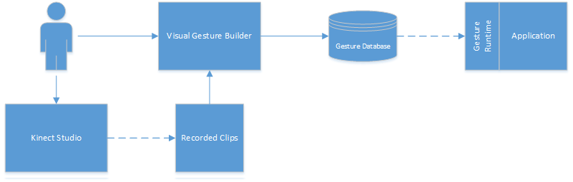

Slide 12
Networking
2 Unity Apps:
Kinect manager and broadcaster (PC side):
  Gets sensing data from Kinect and detects gesture
  Sends gesture (ie. “leaning forward with 0.8 progress”) over server
Solar system app and player movement (Android/VR side):
  Receives kinect data sent over server
  Based on received gesture data, moves player in the app

Slide 13
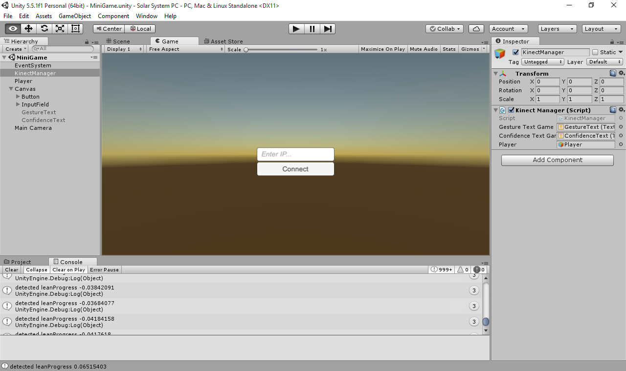

Slide 14
Design Decisions

Slide 15
Finding Natural Gestures
Basic Requirements:
  Majority of users should be able to use the app
  Gestures must work equally well in any direction (ie: even if the user is not facing the Kinect)
Further Requirements:
  Gestures should feel natural to the user and translate into movement such that user nausea/dizziness is uncommon
Notes:
Basic: stop/lock gestures
Further: fine-tuning speed, etc

Slide 16
Finding Natural Gestures (pt 2)
Because of the challenge of having movement work regardless of whether or not a player was facing the Kinect, we had to user test multiple versions of gesture control:
  Version 1: Lean and Sway
  Version 2: Multilean
  Version 3: Multilean + Stop
  Version 4: Multilean + Lock
  Version 5: Multilean + Tap

Slide 17
Reducing Network Latency
Timing needs to be precise because of planet’s size relative to space
Send over as little data as possible between the PC and Android
  Send over an array of gestures, where each gesture is simply a float: its progress level (ex: how far someone is leaning forward)
Have player movement be mostly controlled in Unity
  Based on gesture detected, a Unity script moves the player correspondingly
  Less data and lag than using body-tracking and keeping track of joints

Slide 18
Interesting and Fun VR Experience
Problem:
Having solar system rendered to-scale would be difficult and boring to navigate in VR (moving through space for full minutes before seeing anything)
Automating player movement would defeat the purpose of Kinect gestures
Solution:
Distance between planets is not to scale to make it more enjoyable and easy for users to move through it. However, planet rotation and revolution are to scale.

Slide 19
Demo

Slide 20
Questions?

