Slide 1
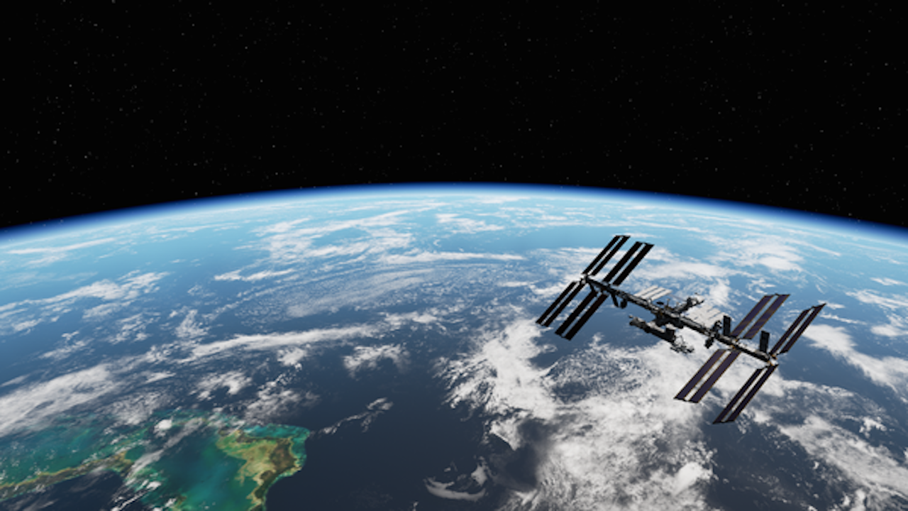
The Final Frontier
The Magic School Bus
Panya Gupta | Sumit Banerjee | Cody Hanson
panyagupta@uchicago.edu | banerjeesum@uchicago.edu | cjohnhanson@uchicago.edu

Slide 2
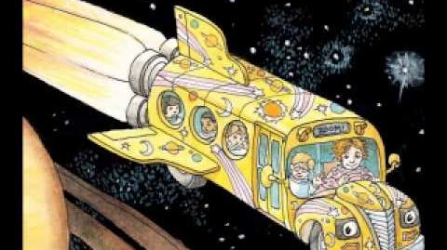
Space Education
PROBLEM
Space is awesome!
Space travel is expensive
Inaccessible to the public
Traditional education about space is unengaging
SOLUTION
Immersive VR space exploration experience
Notes:
Sumit
Movie poster: http://www.universetoday.com/wp-content/uploads/2013/10/2013_gravity_movie-wide.jpg

Slide 3
Technical Approach
SPECIFICATIONS
GearVR for player interaction
Realistic physics
Intuitive motion
Interactive environment to promote learning
PROBLEMS
Balancing richness of environment and performance
Intuitive player interaction
Zero-gravity 3D motion that isn’t nauseating
Notes:
Panya

Slide 4
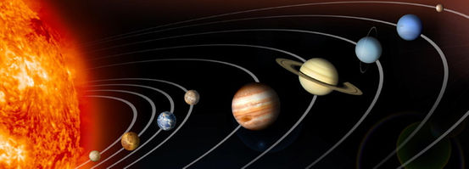
The Result
Environment allows user to explore solar system at their own pace
Toggleable instructions make for quick adjustment to controls
Information about planets
Notes:
Cody

Slide 5
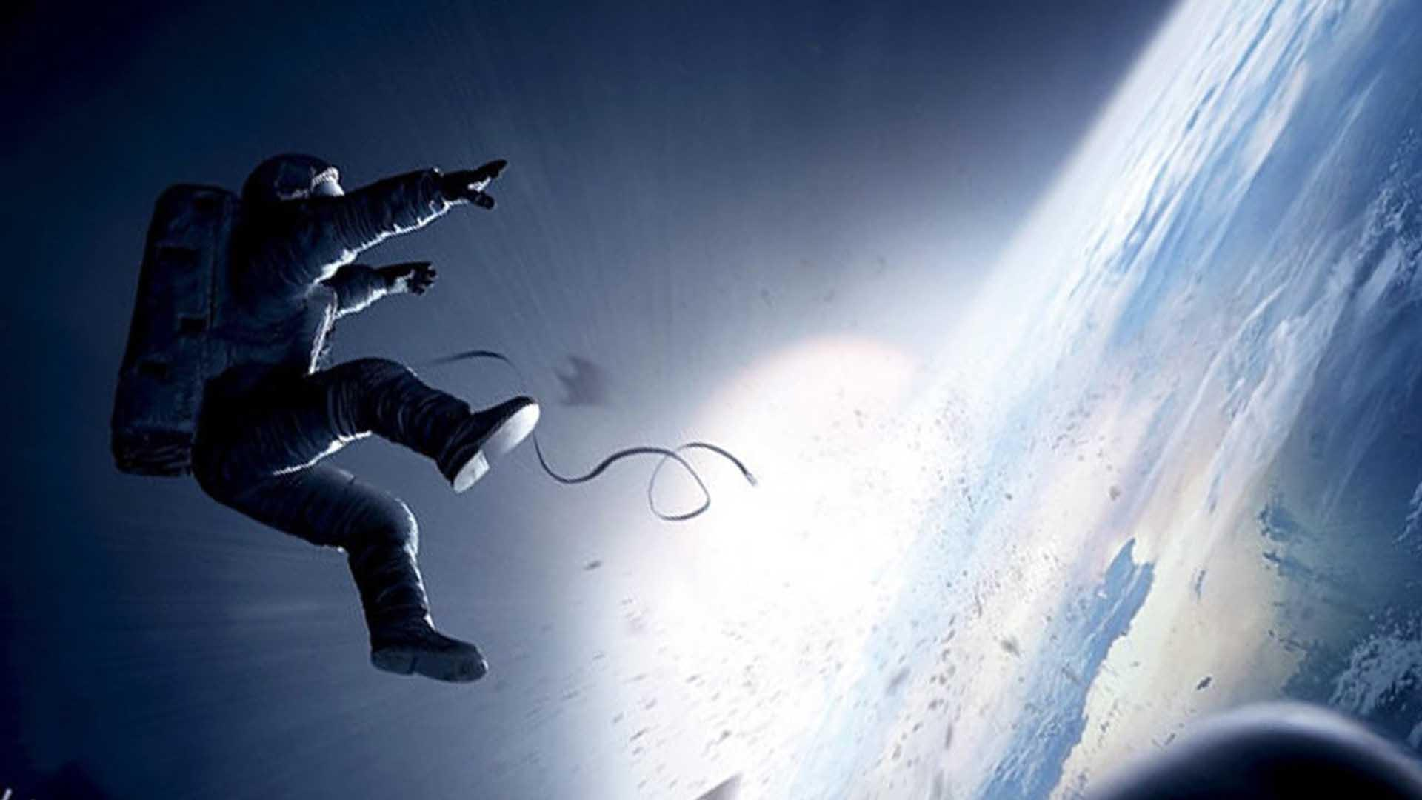
The Final Frontier
Demo

