Slide 1


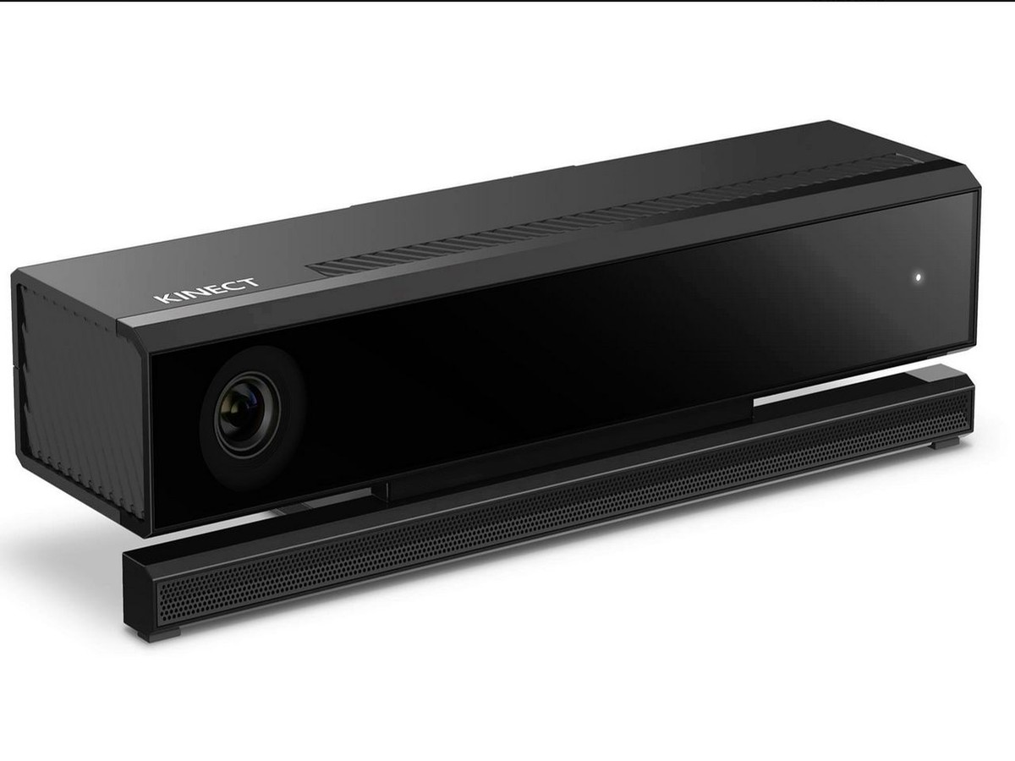
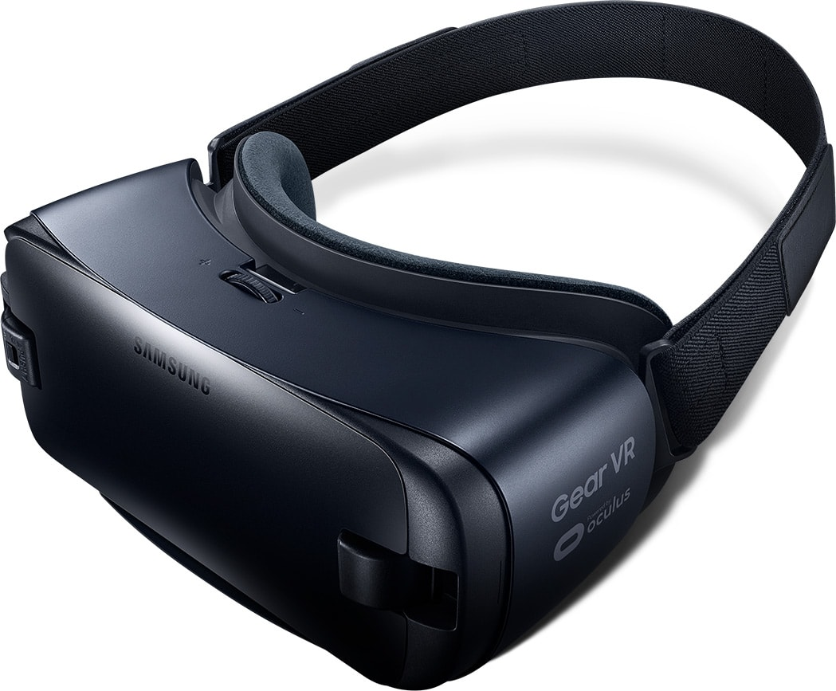

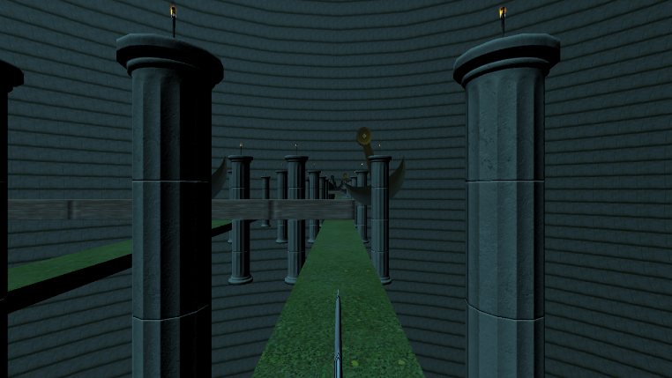
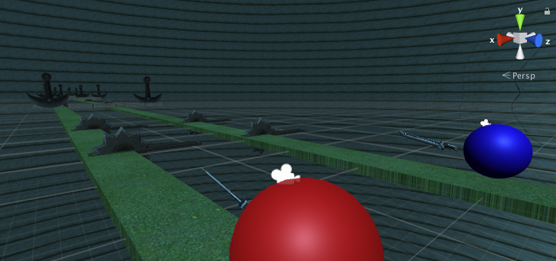
3Duel
24in X
GameVR
36in
Tom Malitz and Jonathan Acevedo
Motivation
Innovations
As avid fans of traditional gameplay, we have been deeply curious about the potential for expanding intuitive gameplay into the expanding market of new technology. Unfortunately, the current trend of game development in the VR community fails to bridge the gap between the immersive experience and traditional, intuitive gameplay that excites the player. We wanted to branch beyond the “look-and-click” games in the GearVR library, expanding to an immersive game that takes advantage of the GearVR while not forfeiting intuitive and immersive game logic and mechanics.
This game expands the utility of two recently innovations in the gaming market—Microsoft Kinect v2 and Samsung GearVR—to produce a gaming experience that is truly unique in the library of either of these pieces of technology in isolation. In so doing, we believe that we have shed light on a potential for future exploration in the development of these and similar
technologies which endeavor to enhance and expand the gaming industry. It is quite possible that we will not see a single gaming instrument capable of delivering
Game Design
Our game takes advantages of GearVR to provide user immersion through its free first-person perspective, and delivers a truly satisfying immersive game control with the help of the Microsoft Kinect to derive controls through sensing the player’s body and hand positioning throughout the game.
a compelling gaming experience with VR and/or sensing. Instead, innovators must look for the best ways to combine sensing and immersion technology. We believe that VR and sensing can still have a place in the future of gaming as long as developers continue to push the boundaries.
We deliver a game where two players must compete to reach their end zone along a platform with “live” obstacles that impede your way to victor. Leaning one’s body at different angles controls the speed at which each player travels through the game, and the right hand position relative to the user’s starting position, controls the sword.
Tools, Assets, and Packages
Game Environment: Unity
Assets: Various Assets from the Unity Asset Store
Perspective Device: GearVR
Sensing Device: Kinect
Basic Sensing Processing: KinectVR
Use your sword to knock out wooden plans that are located at the top and bottom of the screen, and make strategic decisions about the speed at which you navigate the platform to avoid saws and sharp pendulums. When balanced well, you will move seamlessly through the game environment, in which you pass columns with active fires—delivering a sense of being truly immersed in the game scene.
Utilizing compromises in multidirectional movement and eliminating the original more active 1v1 gameplay which initially pitted players against each other in favor of a competitive game in which players are constrained to their own game field and obstacles, but can, by virtue of the GearVR free first-person perspective, look around to see how far their opponent has advanced compared to themselves along the path, we believe this game provides a true sense of immersion in a way we do not see in other iterations of GearVR gaming. We have eliminated the most pressing contributors of virtual reality sickness by incorporating a player’s physical movement in the real world to the rate at which the player advances through a scene which feels quite natural and real.
Acknowledgements
This project was completed as part of CS 234/334 Mobile Computing (Winter 2017), taught by Prof. Andrew A Chien with TA support by Gushu Li and Ryan Wu. We gratefully acknowledge the generous support of Samsung in providing GearVR equipment. In producing this game, we relied on the KinectVR third-party package to access basic sensing data.

