Slide 1
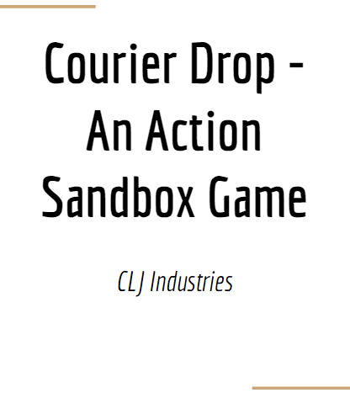
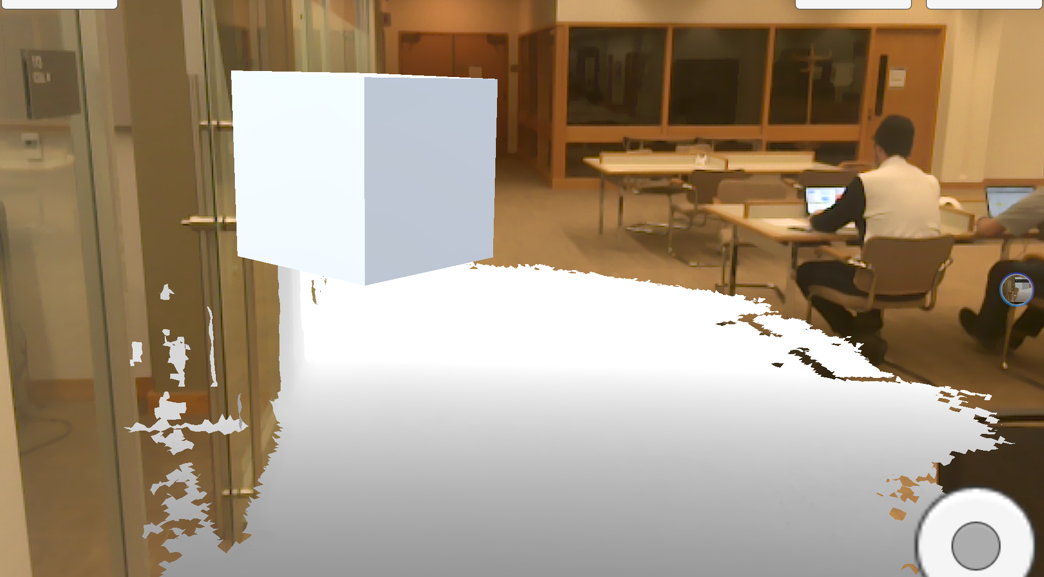
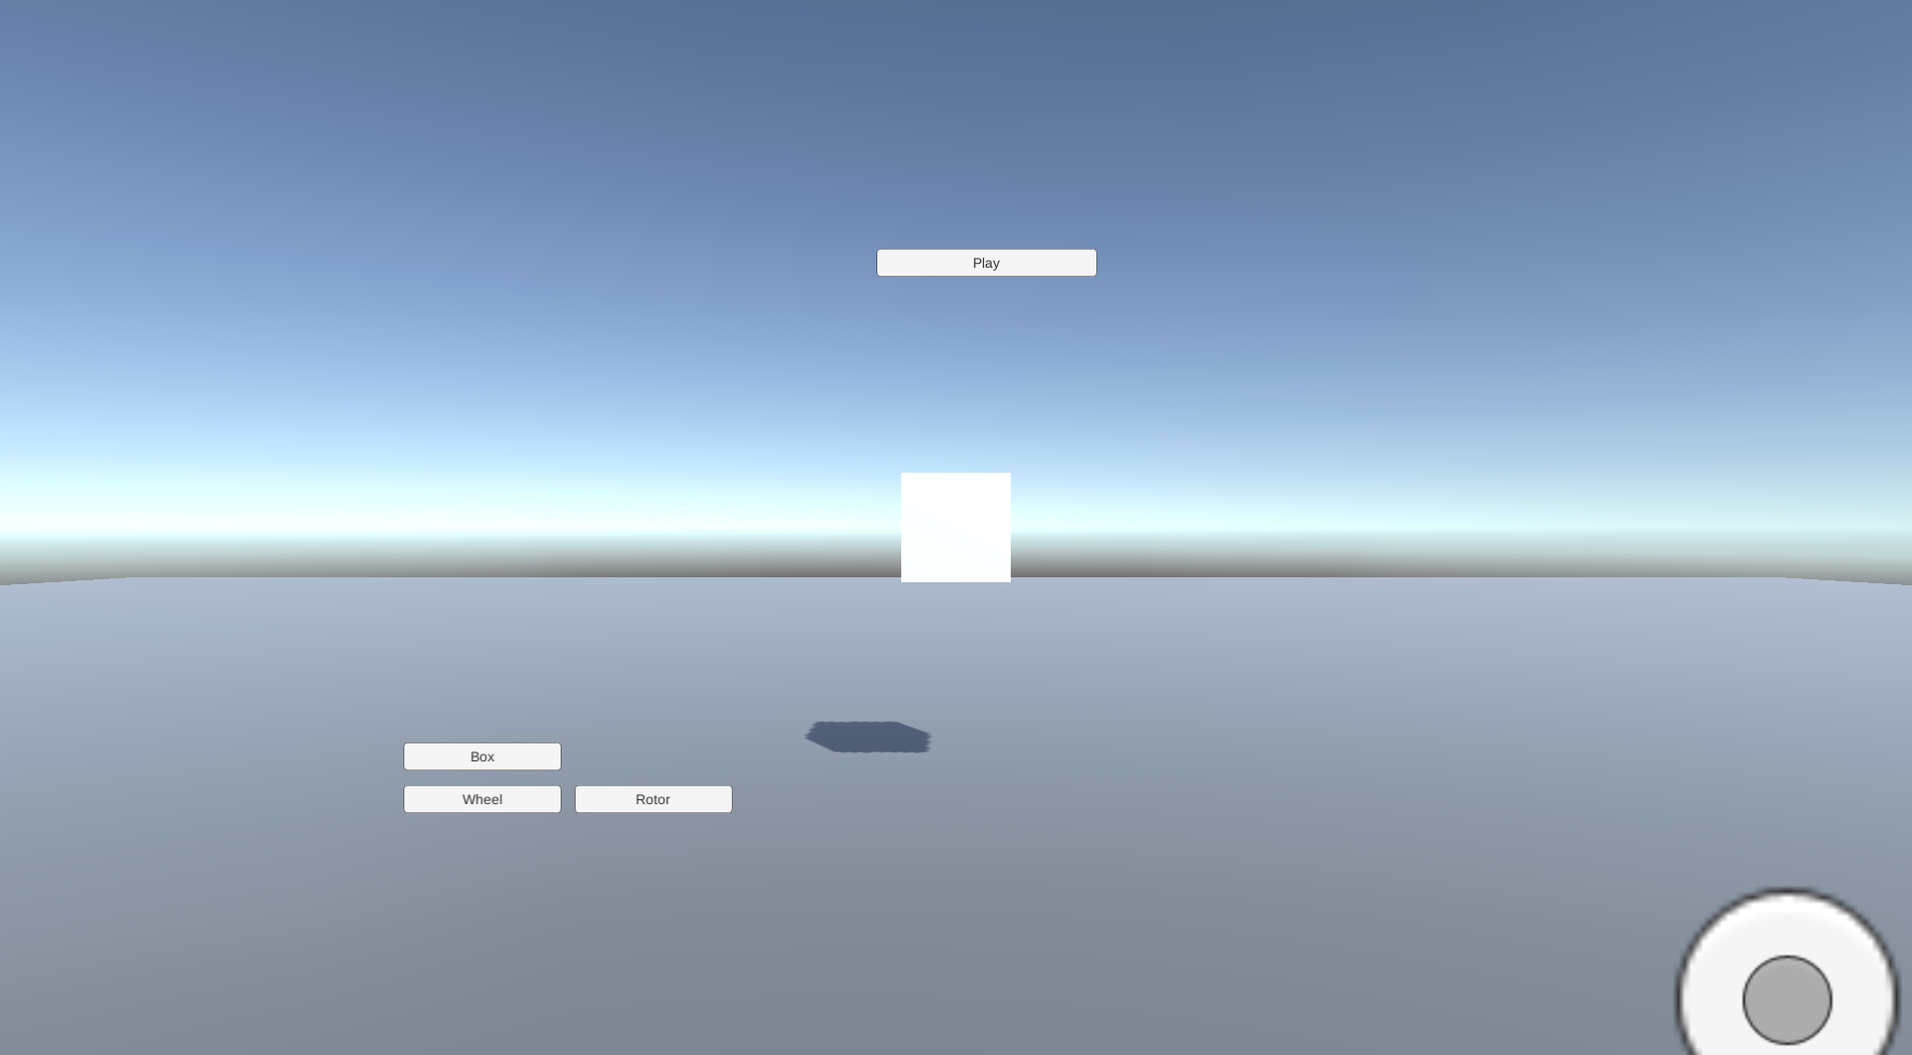
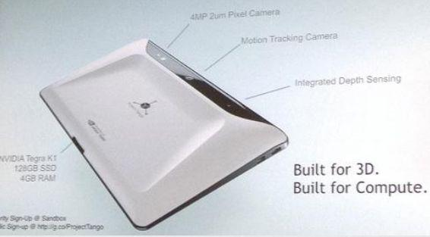
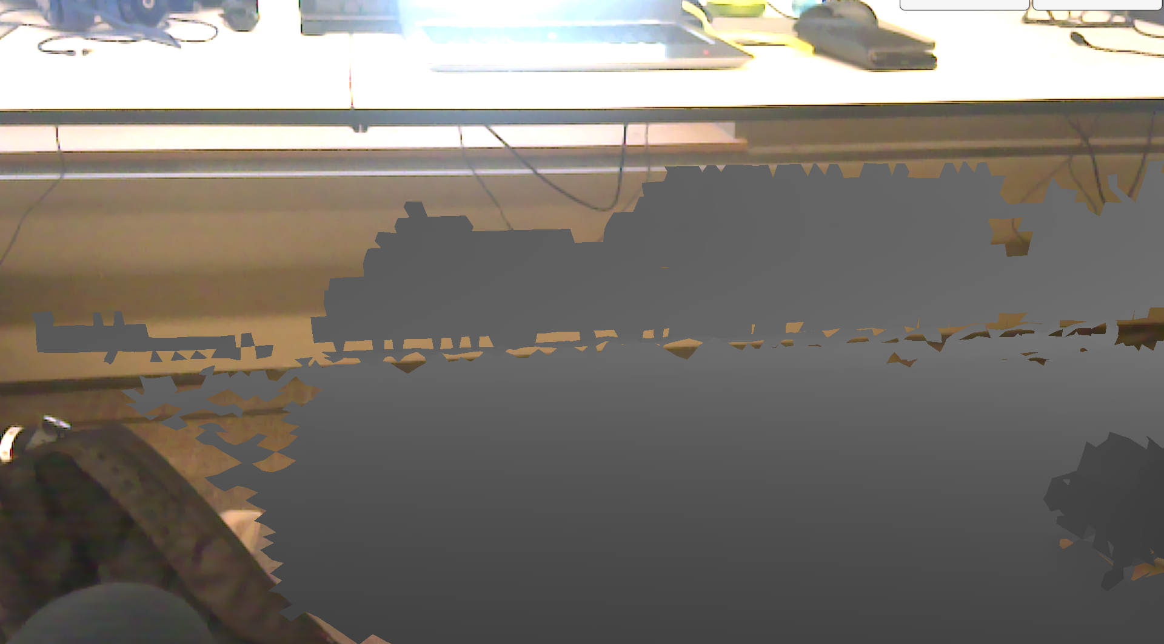
Courier Drop
24in X
CLJ Industries
36in
Chris Eidsmoe, Liyuan Chen, JD Peak
Introduction
Drive Phase
CLJ Industries Presents – Courier Drop, an Action Sandbox Game.
“Courier Drop seeks to meaningful transform the player’s current environment into a detailed landscape upon which this action sandbox game is based. Players assume the role of a CLJ Corporation courier, whose job it is to deliver trinkets to the rustic hermit who has been CLJ Corp’s most reliable customer for the past decade and whose support CLJ must secure in order to ensure the livelihood of the company. However, the hermit has a fear of heights of and likes living in low, dank places whereas CLJ Corp is situated loftily on top of Mount Highpeak. To make matters even worse, all of CLJ Corp’s delivery trucks are currently in use, leaving the player to assemble one himself/herself out of the spare parts lying around the office. Relying only his ingenuity and creativity, the player must create a robust vehicle that can safely navigate the various drops, surfaces, and other environmental conditions to safely deliver the trinkets.”
The final phase of the game, the driving phase, is one where players will put to the test how robustly they designed their vehicles so that it can withstand the environmental hazards that will be put in its way. One of the difficulties we had with implementing this phase was having our digital vehicle properly interact with the real world environment; it was difficult to make sure all the edges and surfaces were correctly modeled and detected by our game engine so that the vehicle reacts just as if it were an actual physical vehicle in the room. A few of the racing games currently out for the Tango Tablet have this problem (cars will drive through real world objects and not properly collide, cars driving on a flat surface will inexplicably get stuck, etc), mostly because of Tango’s inaffinity for fine detail.
Design Phase
While brainstorming the concept for Courier Drop, we drew heavy inspiration from another hit indie game called Kerbal Space Program. In this game, players must assemble a rocketship out of a bunch of spare parts and and fly their makeshift rocketship from the Kerbal Space Station in Florida all the way to the moon. Though Kerbal Space Program is neither the first game to feature player built contraptions nor the last (other games like Minecraft, Besiege, Scrap Mechanic, and Garry’s Mod come to mind), its design interface and clean aesthetic impressed us. When designing your rocketship, hovering over a component seamlessly brings up a item description and an accompanying context menu that allows you allows you to alter the part anyway you see fit. Once selected, the parts snap on and can resize as well, making the construction process quite intuitive and very fun to conduct. In our design phase, players have the opportunity to construct their cars that they will deliver with. The default model is only a simple square, however there are powerful customization options that are available.
Technology Used
For this project we made heavy use of Google’s Tango Tablet. The Tango Tablet implements Google’s Tango API with advanced location sensing. In essence the tablet without using GPS or other external signals, is able to sense its location within a room natively.
Tango is different from other emerging 3D-sensing computer vision products, in that it's designed to run on a standalone mobile phone or tablet and is chiefly concerned with determining the device's position and orientation within the environment.
The software works by integrating three types of functionality:
Motion-Tracking: using Visual Features of the environment, in combination with accelerometer and gyroscope data, to closely track the device's movements in space
Area learning: storing environment data in a map that can be re-used later, shared with other Tango devices, and enhanced with metadata such as notes, instructions, or points of interest
Depth Perception: detecting distances, sizes, and surfaces in the environment
Together, these generate data about the device in “Six Degrees of Freedom" and detailed three-dimensional information about the environment.
Scan Phase
In order to create your racecourse, you must scan the room around you. Once scanning the room, a mesh of the room will be created that will generate a race course for you. This race course will automatically generate a player starting point as well as a destination “home” that you are delivering to. See the mesh generation below.
Acknowledgements
This project was completed as part of CS 234/334 Mobile Computing (Winter 2017), taught by Prof. Andrew A Chien with TA support by Gushu Li and Ryan Wu. We gratefully acknowledge the generous support of Samsung in providing GearVR equipment.

