Slide 1

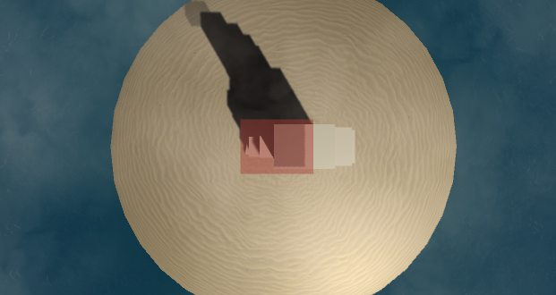
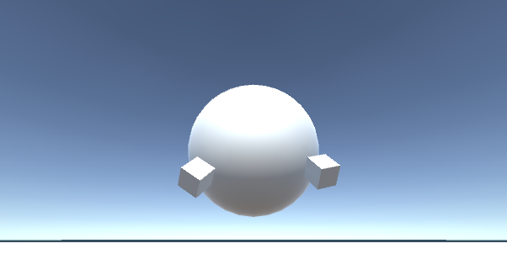
Peeko’s Resort
24in X
team hermit crab
36in
Charlie Kupets / Alex Mueller / Salina Wu
Introduction
Block Stack
Over the past decade we have made giant leaps in the capabilities of interactive media. Two of the most important developments have been VR and motion tracking. These technologies are uniquely capable of creating immersive experiences, but they are not without their faults. VR has yet to be paired with a truly intuitive method of interacting with 3D environments, and motion tracking is traditionally mapped to a fixed 2D screen, which prevents the tracking from being used to its full potential. However, these technologies can be combined to address each other’s shortcomings. Motion tracking provides VR with intuitive controls, and VR creates a 3D environment that allow motion tracking to be used on a larger scale.
Our main goal with Peeko’s Resort was to not only explore the possibilities of this combination, but to also pursue implementations with low-price hardware. VR systems such as the Oculus Rift and HTC Vive cost hundreds of dollars and require powerful computers that adds even more to the already exorbitant cost. In this project, we used Samsung GearVR, a Samsung Galaxy S6 Edge, and a Microsoft Kinect. Assuming one already has a phone and a laptop, the GearVR and Kinect combination is significantly cheaper than traditional VR systems.
With Peeko’s Resort, we created a set of games to explore the potential of VR and camera-based motion tracking. Our goal was to create immersive and intuitive games that could only be implemented using this unique system. The two games we created are explained on the right. We also chose a beach theme, as it would allow us to create an immersive environment for players to get lost in.
Block Stack is a simple game where a block glides across the top of another block, and the player’s goal is to stop the gliding block once it becomes aligned with the block below it. Once the block is stopped, whatever portion of the gliding block that is not resting over the block below it is chopped off. The gliding block stops and a new block of equal size appears above it and begins to glide over the newly stopped block, and the process repeats. The gliding blocks will get progressively smaller as the player stops the block too early or too late and the overhanging sections get chopped off. This will continue until the player stops the gliding block and no part of it is resting above the block below it.
The game sounds simple, but we introduced VR and motion tracking elements into the game to make it both fun and challenging. The play enters the game positioned above the block, and in order to watch the gliding block, they must look downwards onto the gliding block to match it up with the block below it. To stop the block, players must jump. Once the Kinect tracks the jump, the gliding block stops, and either a new gliding block is created or the player loses the game. As the stack gets higher, the blocks begin to move faster. The player camera also moves in tandem with the gliding block, so as the blocks get faster, so does the player.
In addition to the gameplay elements, we created a beach scene that adds another layer of immersion to the game. The block stack’s shadow grows as more and more blocks are stacked, and this shadow helps convey how much higher the player is getting and also acts as a sort of meter for how well the player is doing. The waves crash along the beach, and as the player gets higher, the sound of the waves grows fainter. There is also a cloud layer that the user reaches once they stack enough blocks. The clouds both convey how high the user is and also obstructs the player’s view to make properly stopping the block more difficult.
Technical Aspects
We used a Samsung GearVR with a Galaxy S6 Edge to render our Unity project in VR, and a Microsoft Kinect 1 and a laptop were used to track motion and gesture data. The VR setup had no way to directly get motion tracking data from the Kinect, so we set up a networking system between the laptop and the mobile phone. The phone acted as a server while the laptop was a client. A Unity app ran on the laptop, and this sent Kinect data to the phone. In order to streamline the messaging process, we created specific messages for each game in order to only send the specific information needed for the game.
Takeaways
We learned several important things while completing Peeko’s Resort. Firstly, we learned to use our creative and imaginative mindsets to develop ways to combine Virtual Reality and motion tracking. This involved creating games that wouldn’t be able to exist without both technologies and adding various nuanced details to maximize the realisticness of the VR. Some of details include translucent clouds and logarithmic falloff of volume levels.
However, we also learned that it can sometimes be beneficial to make certain sacrifices in game development. When tracking bodies and mapping them in VR, after initially trying to making the mappings as realistic as possible, we ended up abstracting out the body parts into primitive shapes. This helped reduce sensory conflict by drawing the user’s attention away from minute differences between their real body and the project of their body in VR.
Another important takeaway was that expectations don’t often align with how our implementation will actually play out. For example, although our Block Stack game worked pretty intuitively, spurious network lags or loss of Kinect motion tracking sometimes prevented the game from being played with perfect timing or to completion. As discussed throughout our class, network lag (in our case, between the computer and phone) is a barrier to overcome and not easily fixed.
Working with Kinect and VR also offered a lot of insight into working with sensing and mobile technologies. We took advantage of extensive libraries and documentation that exist, including joint and motion tracking. Nonetheless, we ran into several issues with the way Kinect does body tracking. Kinect senses bodies based on arm placement, and so the Kinect doesn’t know how to interpret a sideways person. Likewise, when a person is facing away from the sensor, Kinect simply believes the person is facing forward. We worked around these issues by tailoring our games to not require facing sideways or backwards, but this limited our vision of a fully 3D environment.
Fig. 1: Block stack. The user looks down onto the top of the stacks so they can align the gliding block. Jumping would create a new block on top of the stack.
Keep Up
When children see a balloon floating towards the ground, it is almost instinctual for them to try to keep it from hitting the ground. Some kids hit it with their hands while others try to kick it up with their feet. This basic game is what we tried to replicated with Keep Up. The game starts with a ball dropping right in front of the player, and it is the player’s goal to keep the ball from hitting the ground in anyway possible. We used hand and feet tracking data from the Kinect and use data to position your in-game hands and feet, which can then be used to bounce the ball.
We originally planned on implementing positional tracking as well and allowing players to move about the space to follow the ball after they hit it. Due to technical limitations and time constraints, this was unfortunately not properly implemented in the game.
Acknowledgements
This project was completed as part of CS 234/334 Mobile Computing (Winter 2017), taught by Prof. Andrew A Chien with TA support by Gushu Li and Ryan Wu. We gratefully acknowledge the generous support of Samsung in providing GearVR equipment. We would also like to thank Rumen Filkov as we could not have completed this project without his Kinect with MS-SDK package.
Fig. 2: Keep Up. The blocks are mapped to the user’s hands, and the ball is the balloon. The user moves her hands to trigger the blocks to move, trying to hit the balloon upwards.

