Slide 1
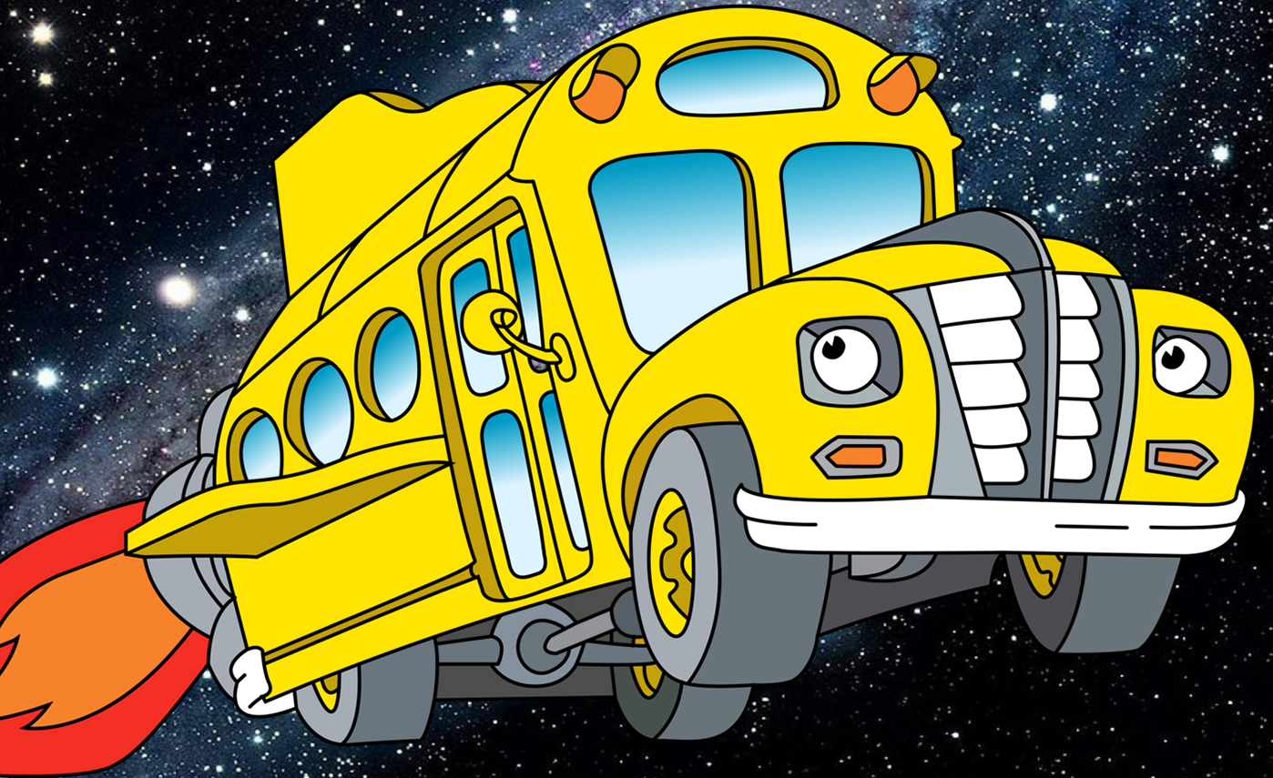
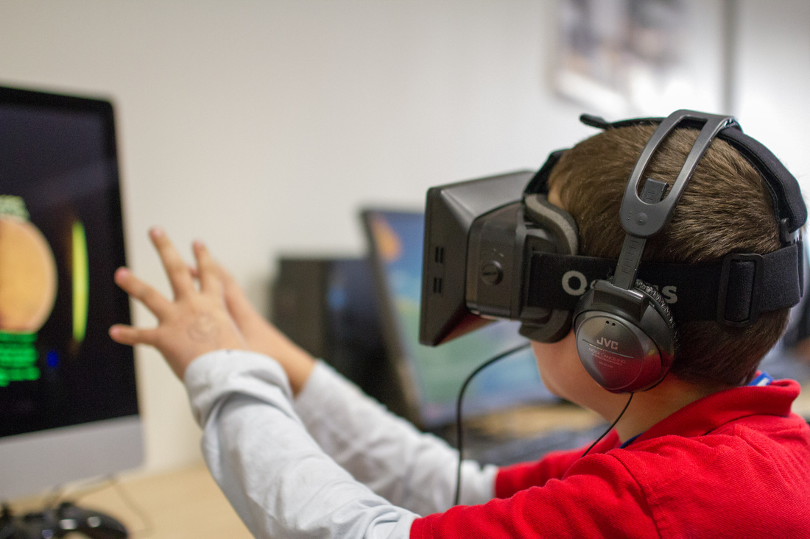
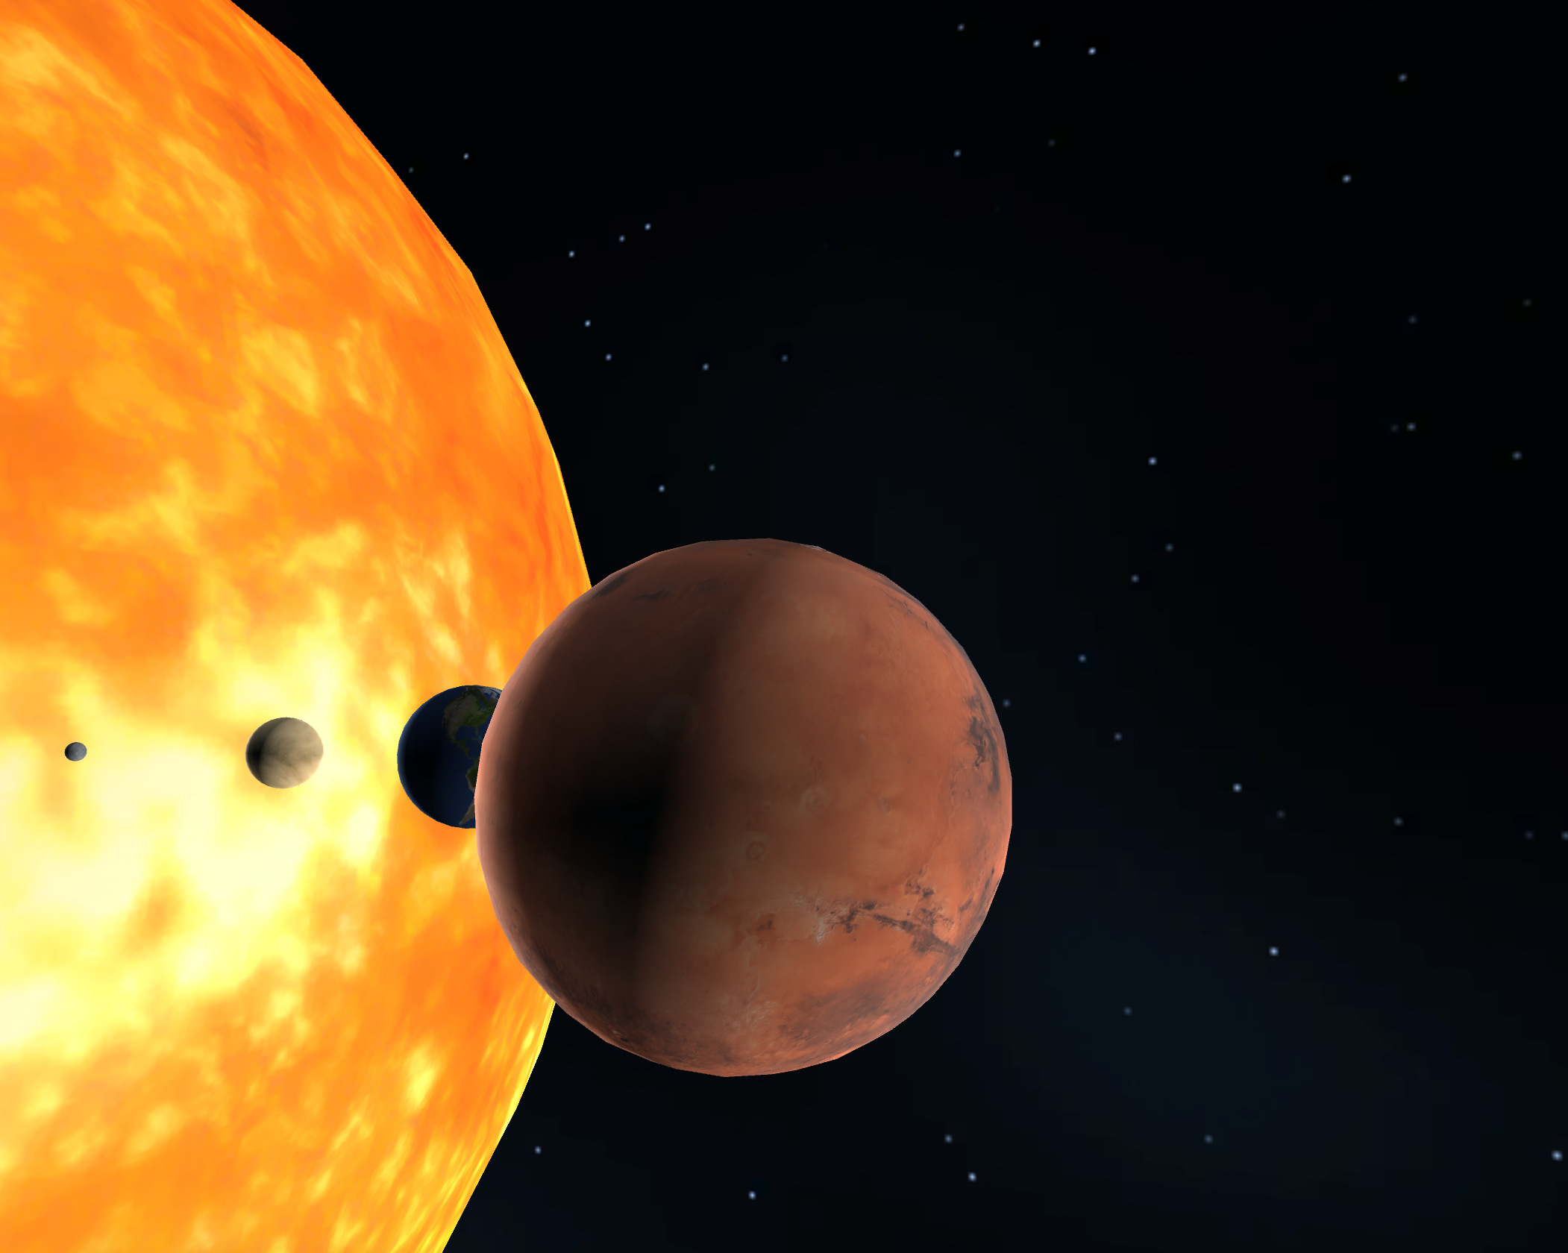
The Final Frontier
Magic School Bus
36in
Sumit Banerjee, Cody Hanson, Panya Gupta
INTRODUCTION
CONCLUSION
Traditional elementary level school education can be quite static and rooted in traditional methods that do not necessarily take advantage of the latest advances in consumer technology. Even for a topic as dynamic and appealing as outer space, education in the classroom can be restricted to sitting at a desk and memorizing rote information such as the order that the planets fall in or what elements their atmospheres are composed off. While this is of course all information worth learning, we undertook our project under the premise that such education can be achieved in a much more immersive, organic way that is ultimately more effective. With this goal in mind, we utilized VR technology to create a space-themed educational app which allows students to explore the solar system and learn about its components at their own pace.
Through this project, it became clear to us that creating a rich and enjoyable user experience is the real difficulty when developing technology. Even when the technical goals are not extremely difficult, creating a product and interface that will appeal to people is very difficult. This requires both creativity and a great focus on human-centered design. This is especially applicable with mobile and virtual reality technologies, as both as supposed to interact with people’s understandings of their everyday lives seamlessly -- mobile because it is meant to be ubiquitous and virtual reality because it is meant to mimic reality completely. This makes the successes of the mobile products already on the market even more impressive.
In terms of the planning and execution of a team project, the structure provided through the various proposal deadlines and check-ins with the TAs helped immensely. The detailed proposal allowed us to flesh out our ideas before we started any development, which helped us maintain sight of a tangible goal. The weekly check-ins created a more rigid timeline that we otherwise may not have followed. In the future, however, we would plan on discussing the user interface as well as our goals for the included educational content more with each other in order to develop a single vision that we all worked towards. Since we had not discussed the these features in specific detail as a group, we each were working towards different conceptions of the user experience. This was mostly a communication problem.
APPROACH
REFERENCES
​The technical problems that we needed to solve to develop the Final Frontier demo can be organized into three categories: creating the scene, creating realistic motion, and adding educational components and information about the Solar System. The first was fairly straightforward -- the challenge was ensuring some degree of scientific accuracy through sizing the planets to scale and making the planets rotate along the correct axis and degree of rotation. The second was more challenging because of the balance necessary between an enjoyable user experience and realistic physics and motion in a zero-gravity environment. A more realistic experience would have been very nausea-inducing in a user, as we discovered through playtesting the app. We decided in favor of the user experience instead of scientific accuracy for obvious reasons, and instead, added space propeller sound effects to help the user feel as if he were moving faster than he actually was. Finally, the third was also very straightforward, as we decided to pull basic scientific information about each planet from Wikipedia and display it. The main challenge here was to display this information in a way that was intuitive and easily understandable for the user.
Acknowledgements
This project was completed as part of CS 234/334 Mobile Computing (Winter 2017), taught by Prof. Andrew A Chien with TA support by Gushu Li and Ryan Wu. We gratefully acknowledge the generous support of Samsung in providing GearVR equipment.
Notes:
1

