Slide 1
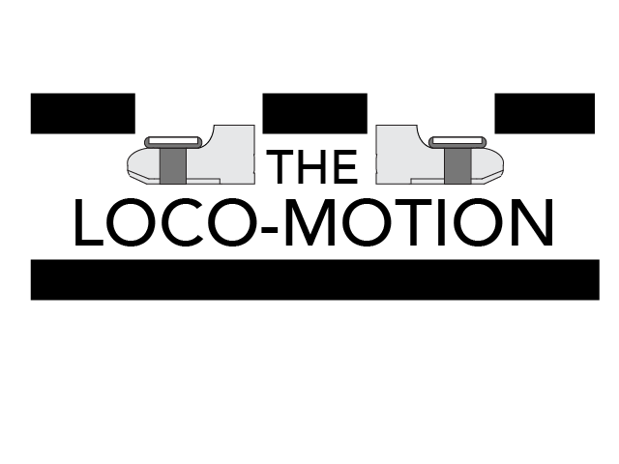
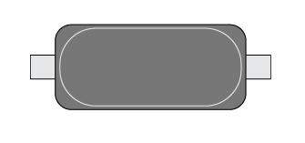
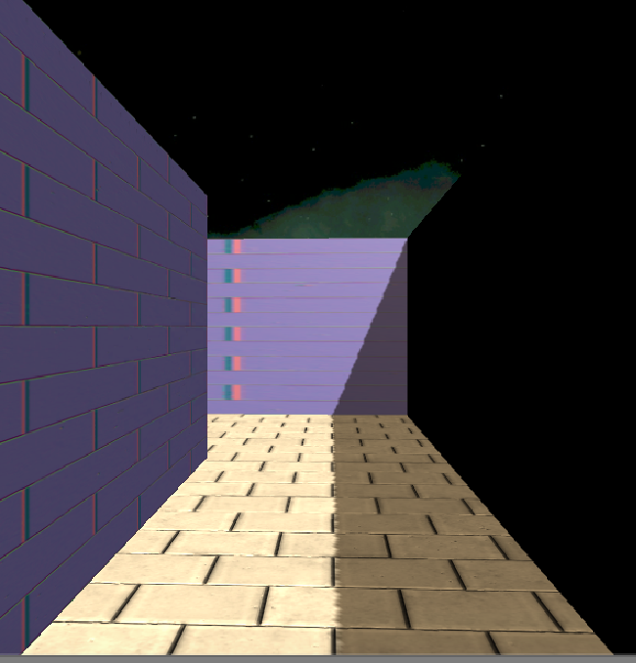
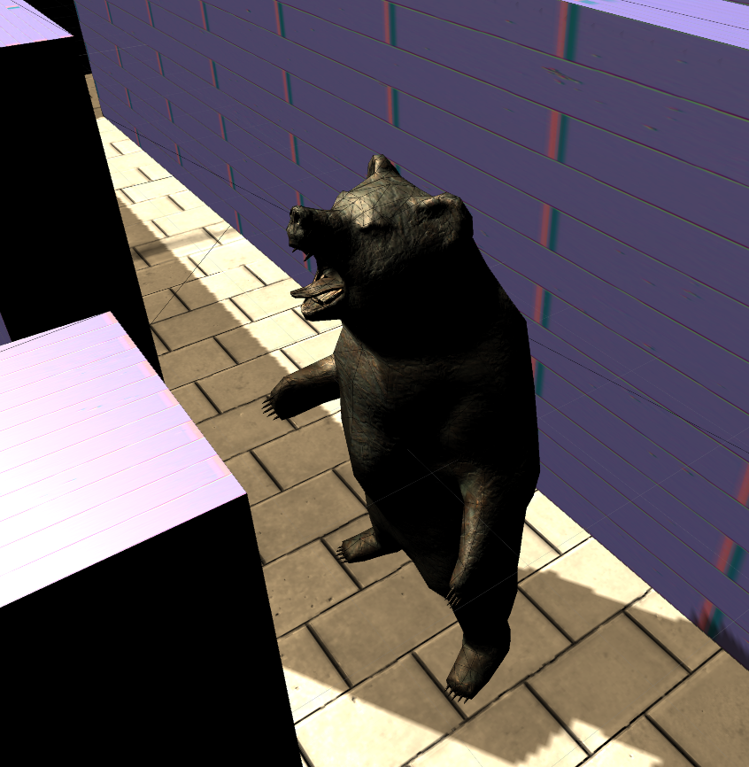
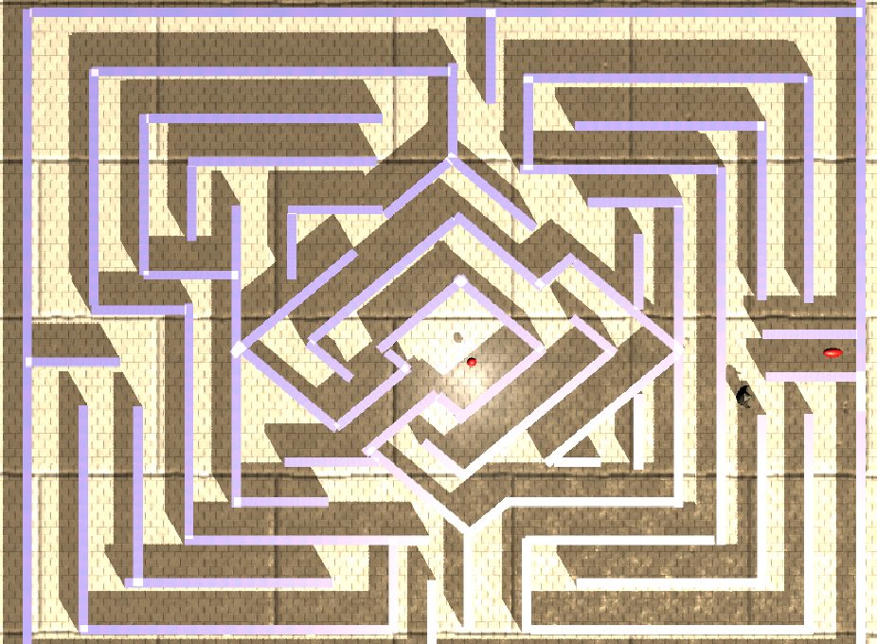
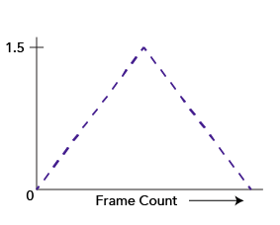
The Loco-motion
36in
24in X
Watch Out for Bears Sofia Wyetzner and Geoff Ramseyer
INTRODUCTION
CONSCLUSIONS
Virtual reality applications have the potential to put users into entirely new environments. Modern virtual reality systems focus primarily on overriding visual and audial input, as the human mind uses these as its primary tools for perceiving the environment. This works reasonably well when the user is stationary, but when the user’s point of view moves in the virtual world without moving in the physical world, the brain detects a discrepancy between the perceived motion as measured by the eyes and the perceived motion as measured by the inner ear. This one of the primary causes of motion sickness in virtual reality.
We created system in which the user can control their motion in the virtual real world by moving their feet up and down in place. This partially tricks the user’s brain into thinking that it is moving in the physical world, which would align the mind’s perception of physical motion with the eye’s perception of physical motion and thus reduce or eliminate motion sickness for the user.
Using the accelerometer and gyroscope sensors in the Samsung Galaxy S6 phones, we measured movements in users’ feet. The phones were strapped to the data collection area, the feet, in order to keep the phones face up to constrained orientation and get a more regular movement. The Loco-Motion processes these sensor signals and sends them to the phone within a VR headset, creating the effect of walking in the virtual environment.
The system we have created simulates walking with reasonable accuracy and reliability. Because our virtual velocity is dependent upon the magnitude of the user’s steps, we simulate changes in pace faithfully as well. In addition, when the network connection is fairly fast, we find that the lag is manageable but still existent. The steps themselves, within virtual reality, are a bit immediate, but less so after a simple tent function was applied to the velocity in VR. In addition, the user must walk-in-place in real space in order to move, but because they are also turning this might cause physical hazards and collisions. Therefore, The Loco-motion should only be used with a spotter.
We have found that the addition of walking-in-place movement to virtual reality enhances the immersive experience. In addition, we performed several user tests to qualitatively assess levels of motion sickness. These finding demonstrated that our system dramatically reduced the amount of motion sickness that users experience.
This project has potential for extension beyond its current state. Because the motion is not perfectly simulated, more sophisticated signal processing algorithm might be employed on the client side to accommodate for the noisy acceleration data. In addition, other movements such as moving backwards or sideways and very small steps are currently not supported. In addition, the system can be simplified to just the necessary sensing components rather than the entire phones. The use of two foot sensors allows for more complex motions to be reconstructed, which could also be investigated.
GAMEPLAY
IMPLEMENTATION
Figure 2. (left) Screenshot of the gameplay environment from the user’s perspective.
Figure 3. (right) Screenshot of a bear that the user must avoid while navigating through the maze.
We planned to create a network between three phones in which the two phones that were collecting movement data would send this information to the phone in the VR headset. It was necessary to minimize lag because any discrepancy between the users’ walking movement and the resulting movement in virtual space would disrupt immersion and might cause motion sickness. It was also important that the movement felt similar to walking in real life, responded to pace changes, and changed directionally.
Networking: In order to pass motion data between the sensing phones and the VR phone with low latency, we used Unity’s Networking API. The VR phone acts as a server and the sensor phone connect as client via WiFi. We achieved this by creating a GUI for the sensor phones in which the user must type in the VR phone’s external IP address and then press a “Connect” button. If the phones are on the same WiFi network, they connect and the sensor phones begin transmitting information to the server with every fixed update. We were able to send the information between the phones with a Command, a Remote Procedure Call that Unity designates to transfer messages from a client to a server. The Command passes a Vector3 that the client has done preprocessing on with respect to the gyroscope’s orientation.
Sensing: The accelerometer produces outputs in 3-dimensional arrays that express the acceleration of the phone through space. Because the information it collects is a second derivative of the positional data, it is mathematically difficult to reconstruct exact position of a user’s foot. Thus, we use the magnitude of the acceleration as a proxy for velocity. We reconstruct the direction of movement with the orientation of the phone and the absolute direction of the acceleration.
Simulating Movement: Once the velocity is sent to the server, we reason whether the user has intending a step. We implemented a threshold magnitude to record sensing information and a minimum number of updates that this movement must have been recorded. If these two parameter are met, we edit the velocity of the player’s character in VR. In order to make the steps seem more nature we used the following basic function on the velocity:
The Loco-motion uses a sample gameplay environment to demonstrate a potential use for its motion sensing. The environment includes a first-person maze that the user must navigate to the center in order to win (Fig. 2). Furthermore, there are bears that have been placed on certain lengths of the maze (Fig. 3). If the player touches these bears they will end the game. The user must intuit the location of the bears through the shadows on the floor. The maze was created entirely in Unity and using elements from the Unity Asset Store.
Because orientation and direction between two feet is difficult to discern, the control of the player’s direction is operated by the head set. However, anticipating the combination of sensor data and head orientation, the player is constrained to a maze because it mostly involved 90 degree turns, which are easy to track.
The player’s motion follows basic physical laws (the player cannot pass through walls or fall through the floors). However, the environment was designed
to demonstrate basic immersive potential but emphasize the walking-in-place simulation in The Loco-motion. Thus the long the hallways allow the player to exercise the walking sensing.
Figure 4. Overview of the maze.
Figure 1. The function applied over time to each movement in virtual reality. This creates a smoother transition that responds to halts.
ACKNOWLEDGEMENTS
This project was completed as part of CS 234/334 Mobile Computing (Winter 2017), taught by Prof. Andrew A Chien with TA support by Gushu Li and Ryan Wu. We gratefully acknowledge the generous support of Samsung in providing GearVR equipment.

